Slide 1
19CSE103 User Interface Design Semester: 2 Curriculum Reference: 2019
Course Overview

Slide 2
Objectives of this course
First course to think about “Users”
Understand from User’s perspective
How to think like a computer user
How will the user “talk” to a computer to get tasks done
Examples:
How to know about Amrita University
How to know about Amsterdam
How to buy books online
How to read online
How to book tickets online
Focus in this course is to learn tools to design pages for the user to understand/ interact

Slide 3
Course Objectives
Web Programming (or coding):
Similar to solving a puzzle
Consider a human language, like English/ Tamil/ Hindi -- We use these languages to turn thoughts and ideas into actions and behavior.
In programming: the goal of the puzzle is exactly the same -- you're just driving different kinds of behavior, and the source of that behavior isn't a human--- It's a computer.
Programming language: is a way of communicating with software.
People who use programming languages are often called programmers or developers.
The things we tell software using a programming language could be to make a webpage look a certain way, or to make an object on the page move if the human user takes a certain action.

Slide 4
Course Objectives
Programming in Web Development:
web designer is given an end goal like "create a webpage that has this header, this font, these colors, these pictures, and an animated unicorn walking across the screen when users click on this button,"
the web designer's job is to take that big idea and break it apart into tiny pieces, and then translate these pieces into instructions that the computer can understand -- including putting all these instructions in the correct order or syntax.

Slide 5
Course Design
Course Objectives
Course Outcome
Program Outcome
Blooms Taxonomy Level
Remember (L1)
Understand (L2)
Apply (L3)
Analyze (L4)
Design (L5)
Create (L6)

Slide 6
Course Outcomes
CO | Statement | BTL
CO01 | Understand the basics of World Wide Web | L2
CO02 | Understand the fundamentals of HTML5 | L3
CO03 | Understand the fundamentals of CSS and Java Script | L3
CO04 | Design and deploy a simple web application | L5

Slide 7
Classes
Theory and Lab
Mandatory – One note book for both Theory and Lab
Theory – 2 slots per week
Lab – 3 slots per
Evaluation:
Class performance – interaction with Professor
Quiz – online in AUMS
Group activities
Periodical Tests 1 and 2
End Semester
Pattern: “I” – Integrated theory and lab – Tests/ end semester in the same class in front of the computer.

Slide 8
Lecture Topics
HTML provides the basic structure of sites, which is enhanced and modified by other technologies like CSS and JavaScript.
CSS is used to control presentation, formatting, and layout.
JavaScript is used to control the behavior of different elements.

Slide 9
Evaluation Pattern for CSE Courses
Category | Method | Evaluation Pattern |  |  |  | Remarks
 |  | Test 1 | Test 2 | Continuous Assessment | End Semester
Theory – T | 50+50 | 15 | 15 | 20 | 50 | Regular Pattern
Lab – L | 80+20 | 20 | 20 | 40 | 20 | Regular Pattern
Lab Based – I | 70+30 | 20 | 20 | 30 | 30 | Integrated Theory and Lab
Project Based – P | 60+40 | 10 | 10 | 40 | 40 | Integrated Theory, lab and Project
Project – PR | 60+40 |  |  | 60 | 40 | Full Project

Slide 10
Tips, Tricks and Techniques
Continuous Learning
Daily Evaluation (Attendance Marks, class performance)
Weekly lab assessment
Reading text / reference books/ materials
Peer and group discussions on recent technologies/ latest happenings

Slide 11
Plagiarism Policy
Plagiarism -- Plagiarism is copying another person's ideas, words or writing and pretending that they are one's own work. It can involve violating copyright laws. ... Writers who plagiarize commit serious legal and ethical violations. (https://simple.m.wikipedia.org/wiki/Plagiarism)
Tolerance to Plagiarism in this course – ZERO %
If at time any program/ assignment/ work is found to be plagiarized – ZERO marks will be awarded – repetition will result in course cancellation
Learn to work and exhibit your own ideas, learning if you go wrong, makes you learn better and best
Appreciate other’s work

Slide 12
Home Work: 1 – Group Activity Web Page Design – Team of 5
Students to prepare web pages and present in class
5 Ada Lovelace award winners
5 Disruptive Technologies in CS
5 Computer Advertisements
5 Computer Languages
5 Inspiring websites
5 CS competitions
5 CS Applications for Societal problems
5 Advancements in Industries
5 Terminologies: Computational Physics, Computational Chemistry, Computational Biology, Computational Linguistics, Computational Photography
5 Top Universities where CS is popular (outside India)
5 Top CS Researchers in India
5 Top Companies IT in India
5 Multi National Companies

Slide 13
Which Software to use?
Many choices…
Simple Notepad
IDE based: Edit ++, Dreamweaver
IDE – Integrated Development Environment – includes compiler, executer, plug-ins, debugger, etc.
We suggest: Visual Studio Code
Reasons – One IDE for all your programming
Simple integration with run time environment
Auto code generator… ++++
You would experience by yourself

Slide 14
Where is it? How to install?
Lab – Available in the machines
Laptop – for class purposes
http://vidya.amritanet.edu/Softwares/OpenSource/Visual%20Studio%20Code/
Look for your version (32-bit, 64-bit, MAC etc)
Download and install

Slide 15
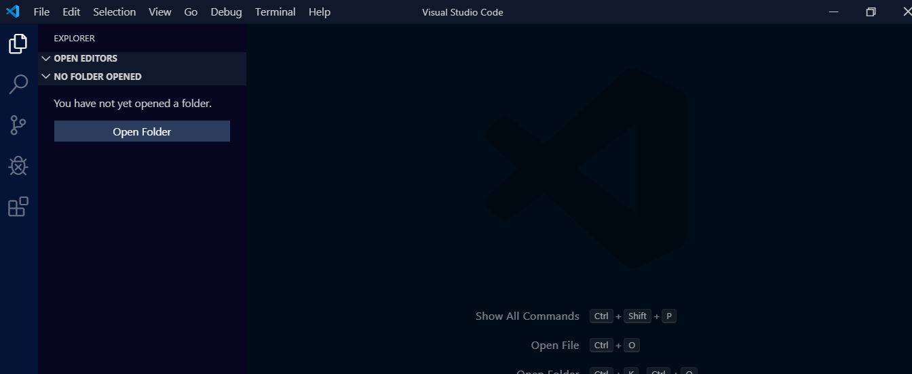

Slide 16
How to learn this IDE
About: https://code.visualstudio.com/docs
Tutorial available at:
https://code.visualstudio.com/docs/introvideos/basics
Not all will be taught at class
More of learning and discussions, than teaching

Slide 17
We shall start now to learn UID
Introduction to Internet, WWW,…
HTML (basic tags, representation of data)
Cascading Style Sheet (formatting and enhancing look and feel)
Java Script (validation of data entered/ captured)

